Slide 1
Quality Assurance in the
Bologna Process, 2020
Information from the BPIR 2020
David Crosier
European Education and Culture
Executive Agency
30 June 2021, TPG C meeting

Slide 2
2020 BPIR
Compared to previous editions, fewer indicators, but key indicators, and also historical perspective (20 years of Bologna)
Information collected in 2019 with reference year 2018/19
Thus the report shows the evolution in implementation prior to output of TPGs
The impact of the TPGs cannot be seen/judged from the BPIR…

Slide 3
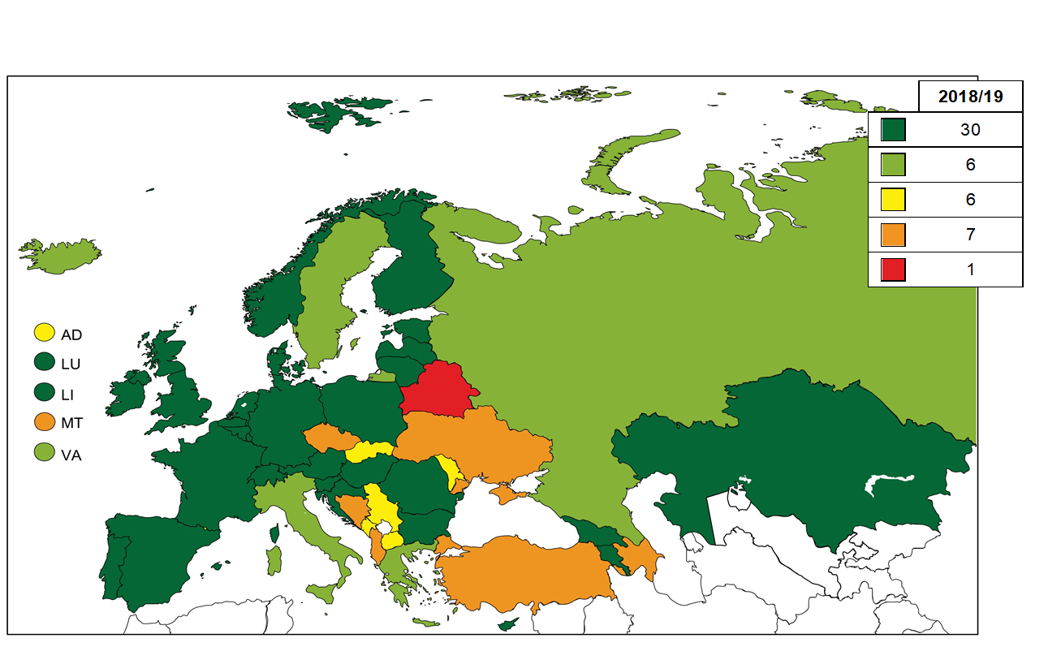
Quality Assurance, 2018/19
MAIN INDICATOR FOR QA
Compared to 2016/17:
6 countries moved to dark green
4 countries from orange to yellow or light green
1 country from red to orange
Progress continues…
Dark Green = EQAR registered agency
Light Green = ESG-aligned but not EQAR
Yellow = EQAR agencies in some cases
Orange: QA system not yet aligned to ESG
Red: QA system not established

Slide 4
Evolution of Quality Assurance
Major changes over 2 decades
From a handful of countries with any QA system in 2000, now almost all countries have internal and external quality assurance systems in place on a system-wide scale
European Standards and Guidelines (ESG) have consolidated EHEA model and provided conditions for trust between systems
EQAR established to oversee correct use of ESG, and working well
However, practice of trust could still be improved…

Slide 5
Level of student participation in external QA
Key point: some improvement in student participation.. However, indicator is moving slowly…
Dark Green = Students full members/fully involved: in: Governance structures; external review teams; preparation of self-evaluation reports; decision making process for external reviews;
Follow-up procedures

Slide 6
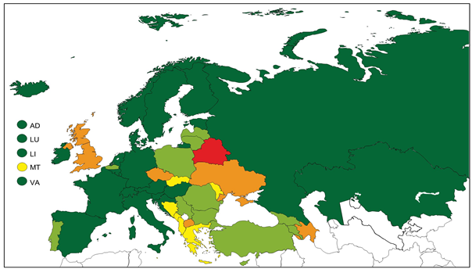
Level of international participation in external QA
Key point: Improvement in a few countries.. Moving in the right direction - but slowly
Dark Green = Agencies are members of ENQA; international peers/experts participate in governance of national quality assurance bodies; in evaluation teams; in follow-up

Slide 7
Level of openness to cross border QA of EQAR registered agencies
Key point: Although this indicator appears quite red, it is improving quite rapidly (eg dark green 2013 8 countries, 2016 12 countries, and 2018 21 countries)
Dark Green = All institutions and programmes + EQAR criterion; Light green = All institutions and programmes; EQAR not a criterion; yellow = some institutions and programmes + EQAR; orange = discussions ongoing; red = No openness

Slide 8
European approach to QA of joint programmes
Adoption in 2015, and European Approach is a simple and effective way of improving external quality assurance for joint programmes: one evaluation, following ESG…
Countries slow to adjust: so far only in 12 countries are all HEIs able to benefit from the European approach
European Universities Initiative and Erasmus Mundus provide very good stimulus for positive change
NB Map shows only the minimal condition of legislation permitting the European Approach

Slide 9
Looking ahead (to a post-covid future)…
European cooperation can/must show its value to society
Quality assurance will need to adapt and continue to evolve
Role for QA to be developed in relation to (inter alia) values, social dimension, microcredentials, sustainable development goals and closer HEI networks/alliances

